Slide 1
Association for Computing Machinery at Ohio State
Spring 2020 - Introduction

Slide 2
Leadership
President : Alex Li
Vice President : Wally Yang
Treasurer: Yifan Zhu
Advisor: Yusu Wang
Notes:
Poster by Gen

Slide 3
What is Competitive Programming?
Hard Puzzles for programming
Learn about lots of problem-solving techniques
Get practice implementing things
Job Interview Questions
Gain skills and confidence

Slide 4
What Do We Do?
Competitive Programming
Lectures
This semester - focus on graph theory
Practice
At home
Competitions
Team finding
Discussions

Slide 5
What you need to know before you start
Passion for Computer Programming
Passion to learn new things
Any Programming Language

Slide 6
Changes from last semester
Biweekly Meetings
Focus on CP
Focus on 1 topic somewhat

Slide 7
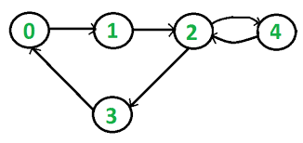
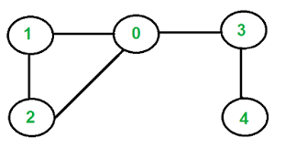
Topic for this semester: Graphs and Flows

Slide 8
Competitions this semester
Battlecode
Election
Google Hash Code
Google Code Jam
Others?

Slide 9
Call for Lectures
Any kind of algorithm related topic
Almost any week
Email: li.8096@osu.edu

Slide 10
Links
Lecture Schedule
Meeting Slides
Simple algorithms reference book
Discord for competitive programmers around the world
Kattis : Official site for the ACM-ICPC contest
Codeforces : Better site than kattis. Has occasional contests.
Project Euler: More mathy problems with only visible 1 test case
HackerRank: More job-oriented programming site

Slide 11
Meeting Problem - Almost Acyclic Graph
Problem - 915D
You are given a unweighted directed graph. Check if removing at most 1 edge makes it acyclic.
Time constraints: The graph has at most 500 nodes and can be dense

Slide 12
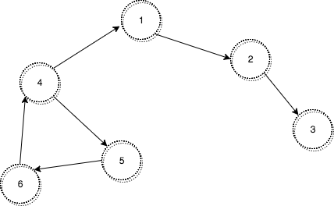
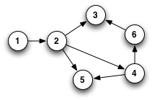
Examples
IMPOSSIBLE
POSSIBLE
POSSIBLE

Slide 13
Brute force strategy
For every edge: Remove this edge, check for a cycle.
How do we know if a graph has no cycle?

Slide 14
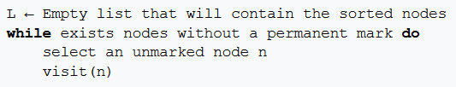
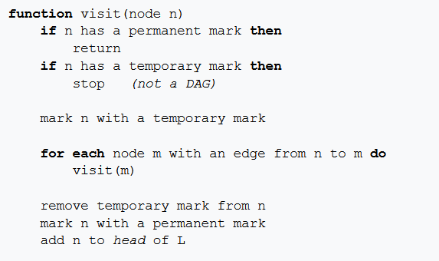
Topological sort!

Slide 15
Time complexity
For every edge: Remove this edge, check for a cycle.
Topological sort takes O(V+E) time, so the total is O(E(V+E)).
How can we improve this?

Slide 16
What does it mean for a graph to be almost acyclic?
One edge must be in all cycles.

Slide 17
Speedup:
First, find a cycle. Then, do the previous algorithm, but only try removing edges from this cycle.
New time: O(V(V+E))!
How do we find a cycle?

Slide 18
Alternate solution
Notice that a graph is almost acyclic IFF
there is a ‘topological sort’ of the graph with at most 1 back edge.
Forward direction: Remove the edge to make it acyclic, sort the graph, and then add it back in.
Backwards Direction: Remove the back edge, the graph is acyclic.

Slide 19
Alternate solution
Hence we just need to try all of the topological sorts!

Slide 20
Alternate solution
Consider the topological sort that begins at the end of a edge from node a to node b which when removed gives an acyclic graph.
Claim: The only backwards edge will be from b to a.
Suppose a,b,c,d are distinct nodes. If there is a back edge from d to c, then there must be a path from c to d as well (because of how topological sort works). But then this cycle does not use the edge a->b at all, so removing the ab edge will leave a cycle, contradicting our earlier claim.

Slide 21
Alternate solution
Do a Topological sort starting from every node, and count the number of cycles.
It’s possible IFF any of these cycles has at most 1 back edge.
Time: O(V(E+V)), same as before (but easier to implement)
https://codeforces.com/contest/915/submission/68332245

Slide 22
Next week:
Representing things as graphs
Weekly Challenge
https://codeforces.com/problemset/problem/1020/B

